Slide 1
shared decluttering
clutter management through shared experience
Chloe Barreau, Cynthia Liang, Amy Xu, Jenny Zhi

Slide 2
initial point of view

Slide 3
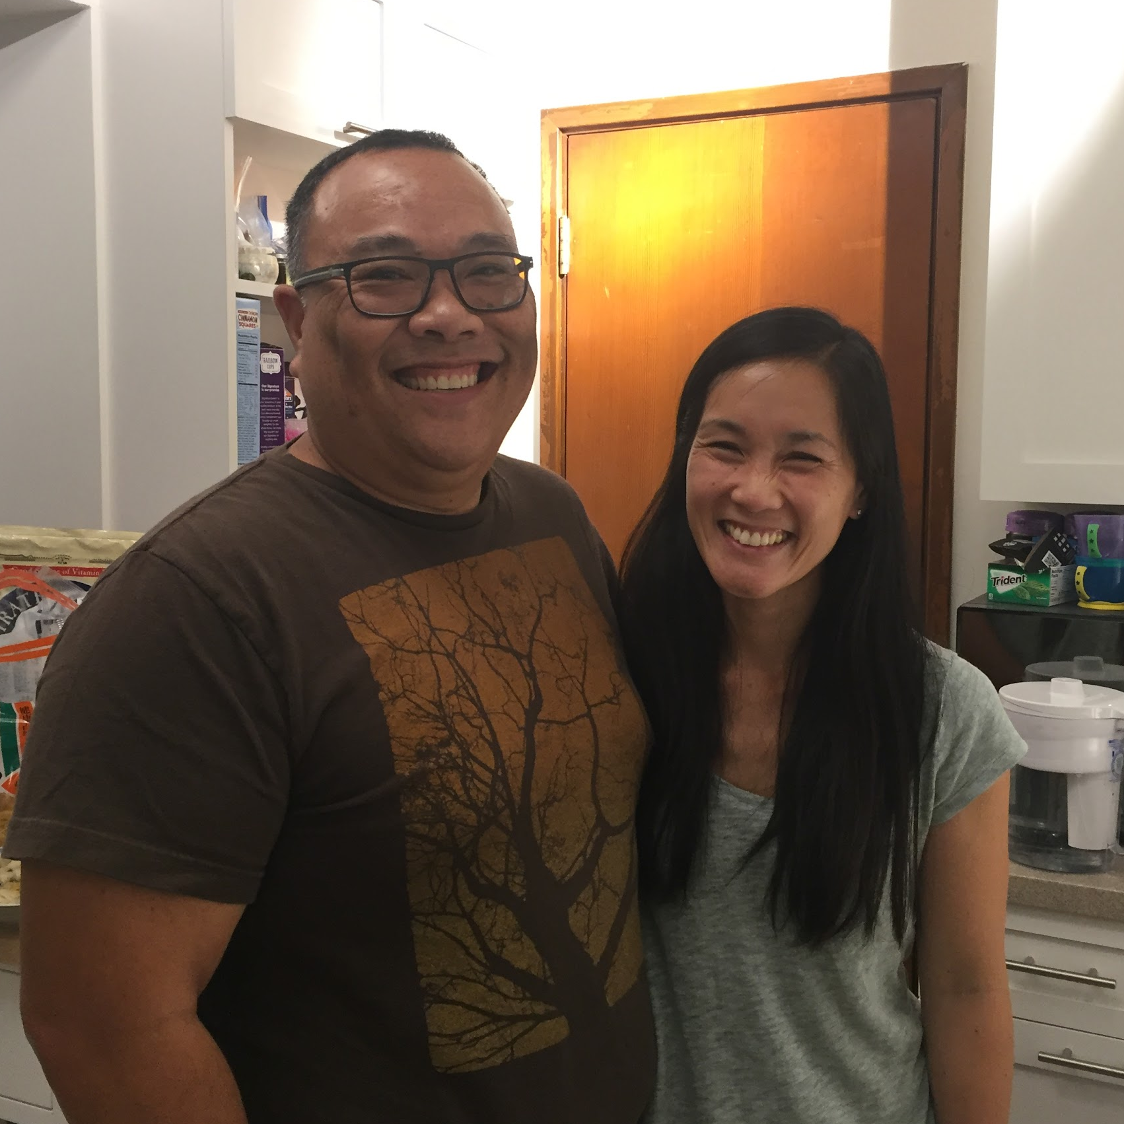

initial point of view
we met
Edith
Okada RF
Professor Snipp
Murray RF

Slide 4
initial point of view
we were amazed to realize that they keep things in storage, forget what's there, buy new things
it would be game-changing to give people better awareness of how they organize space and possessions

Slide 5
needfinding, round two

Slide 6
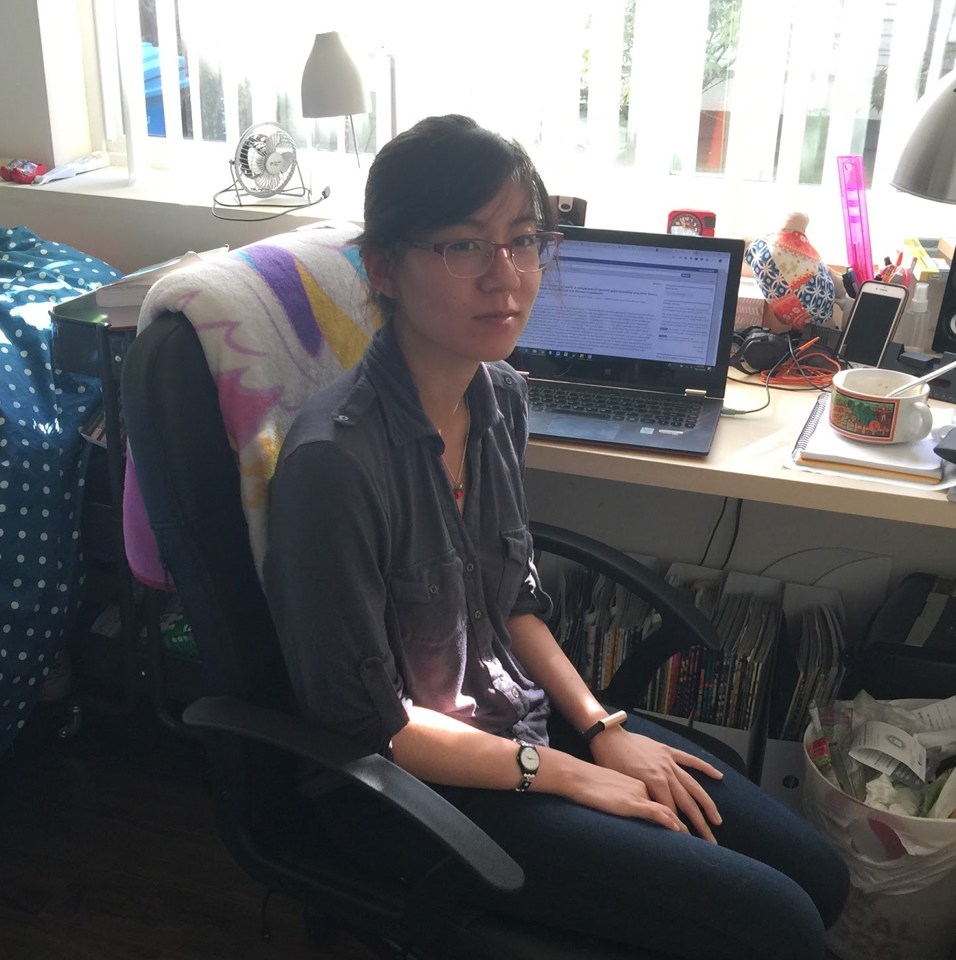
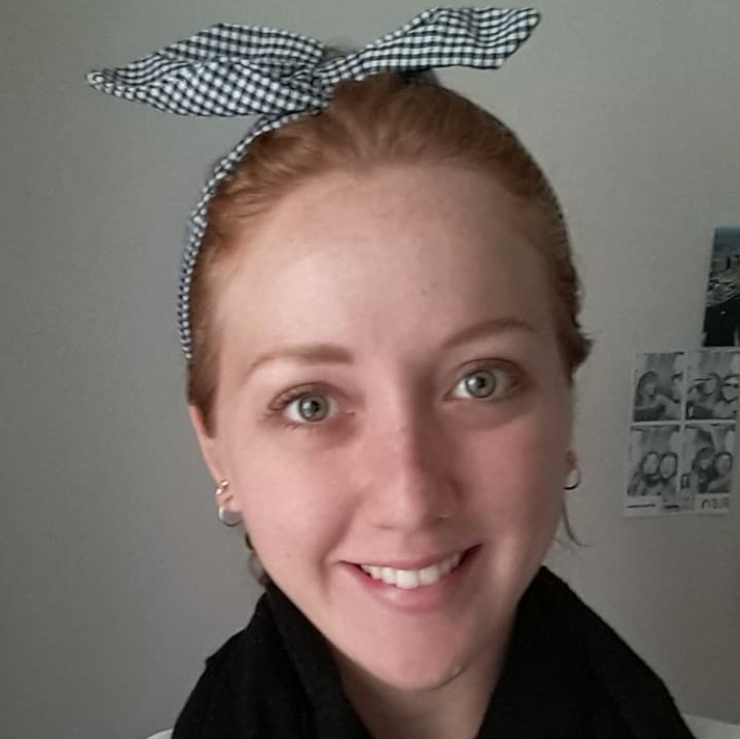
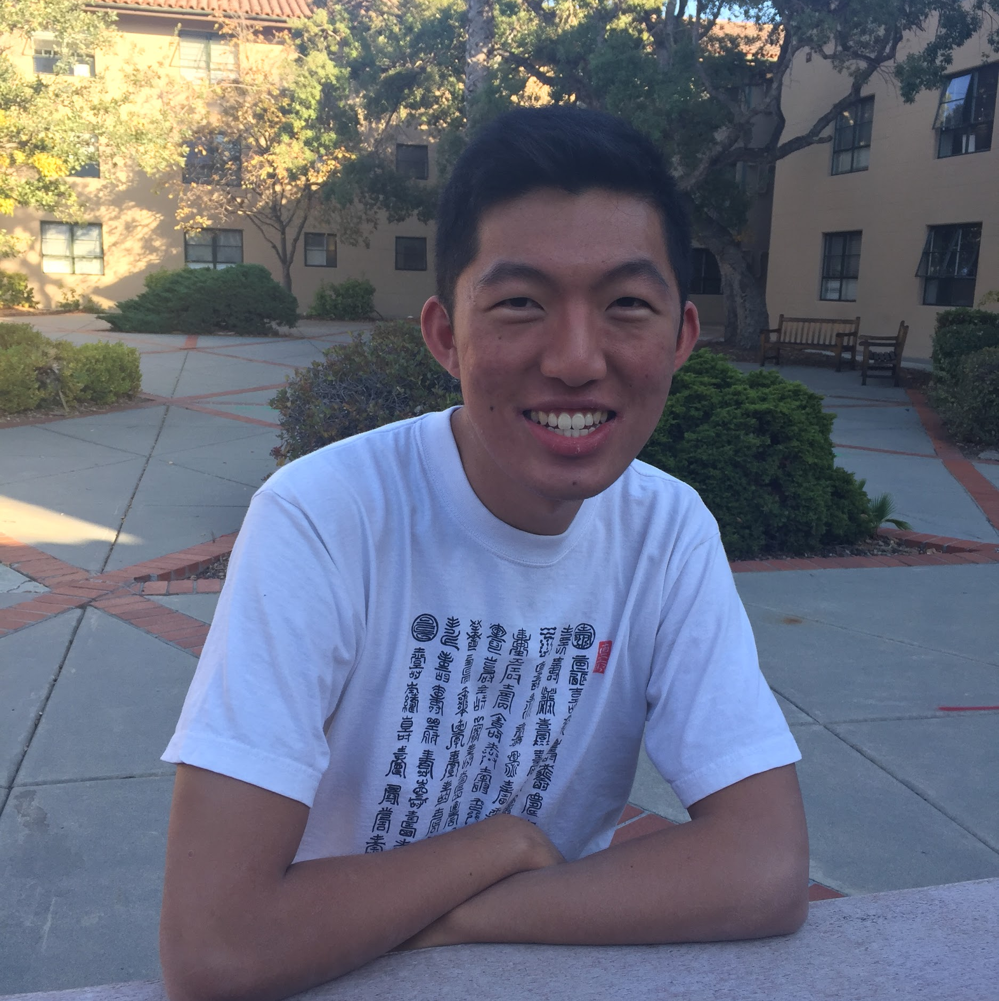
needfinding, round two
Chelsea
Bianca
Cary

Slide 7
needfinding, round two
Chelsea
Bianca
Cary
“I’m assembling a museum of myself”
Notes:
We talked to Chelsea, who recently moved from Berkeley to Redwood City and chose to leave her bed and many of her clothes behind. She described her systems for keeping sentimental things (collect to leave at her parents' home; "I'm assembling a museum of myself"), practical things (keep nearby), digital memories (backup on hard drives by season), and everything else (get rid of).

Slide 8
needfinding, round two
Chelsea
Bianca
Cary
wants to bring objects into the home to make it more personal challenged by limited space and guilt created by new purchases

Slide 9
needfinding, round two
Chelsea
Bianca
Cary
hoarding of clutter due to fear of future attachment
Notes:
We talked to Cary, a Stanford CS AI senior and a semi-professional Youtuber who travels often for Youtube conventions and speed-cubing competitions. He talked about his frequent travelling experiences and notably touched on how he keeps many objectively useless and seemingly unsentimental objects in his household, for fear that he would get more attached to the objects in the future.

Slide 10
needfinding, round two
Chelsea
Bianca
Cary

Slide 11
Chelsea

Slide 12
point of view
we met Chelsea, a journalist/book critic living in a very small room
we were amazed to realize that she leaves big boxes of sentimental objects with parents
it would be game-changing to keep the meaningfulness of these objects without the hassle
Notes:
We met Chelsea, a journalist/book critic living in a very small room. We were amazed to realize that each time she visits her parents, she brings a big box of sentimental things she wants to keep but doesn't need nearby, and leaves them with her parents. It would be game changing if she could keep the meaningfulness without the hassle.

Slide 13
how might we
how might we make seemingly useless sentimental objects a more relevant part of life?

Slide 14
sisterhood of the traveling pants
passing objects

Slide 15
experience prototype
assumptions
people are willing to give up sentimental possessions if they know receiver genuinely wants the gift
shared experiences act as an incentive to do so

Slide 16
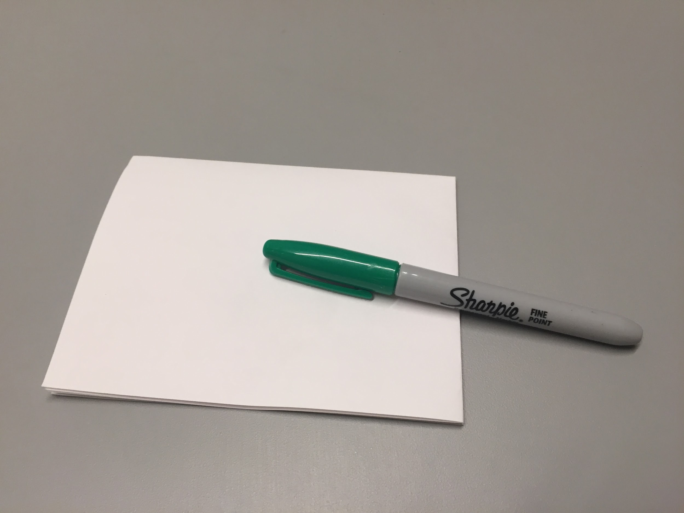
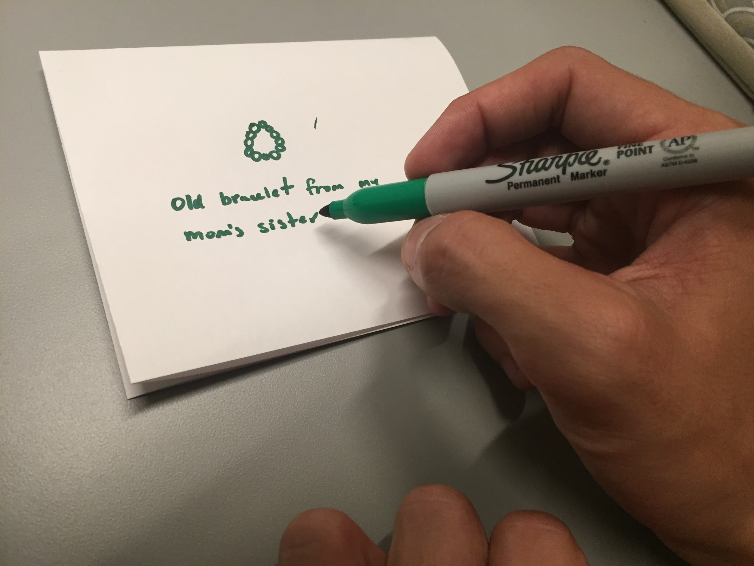
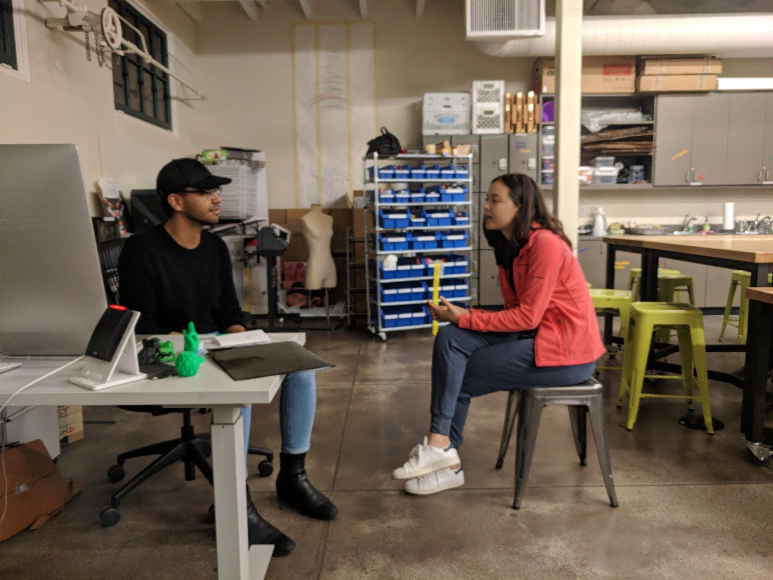
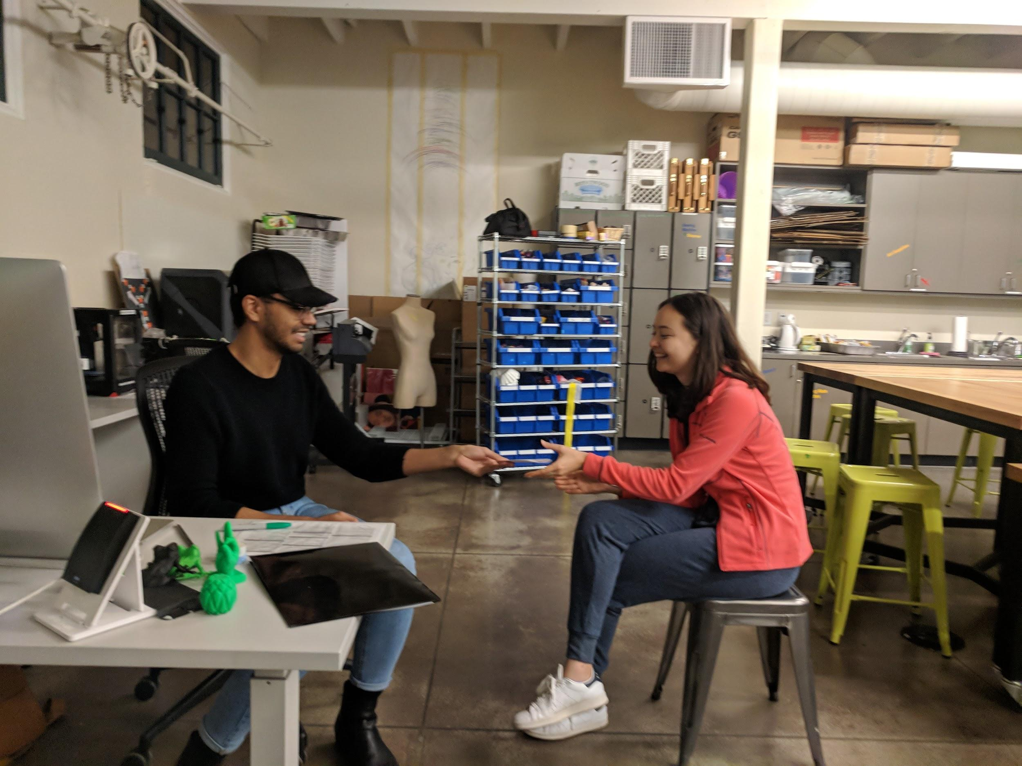
experience prototype
immediate acknowledgement of possession of sentimental yet useless objects
felt good giving bracelet to someone who would value
awkward exchange

Slide 17
experience prototype
assumptions
people are willing to give up sentimental possessions if they know receiver genuinely wants the gift
shared experiences act as an incentive to do so
validated assumption
people are more willing to part with unused sentimental objects if they know they will be meaningfully treated

Slide 18
Chelsea

Slide 19
needfinding, round two
Chelsea
Bianca
Cary

Slide 20
Bianca

Slide 21
point of view
we met Bianca, a student who travels every three months
we were amazed to realize that she uses luggage as storage for clothes that are out of season, but forgets what's in it
it would be game-changing to help her not not feel restrained by space

Slide 22
how might we
how might we help keep track of and fully utilize luggage and/or storage?

Slide 23
home outside of home
packing assistant

Slide 24
experience prototype
assumption
people find value in visualizing their items and planning beforehand when deciding what to pack

Slide 25
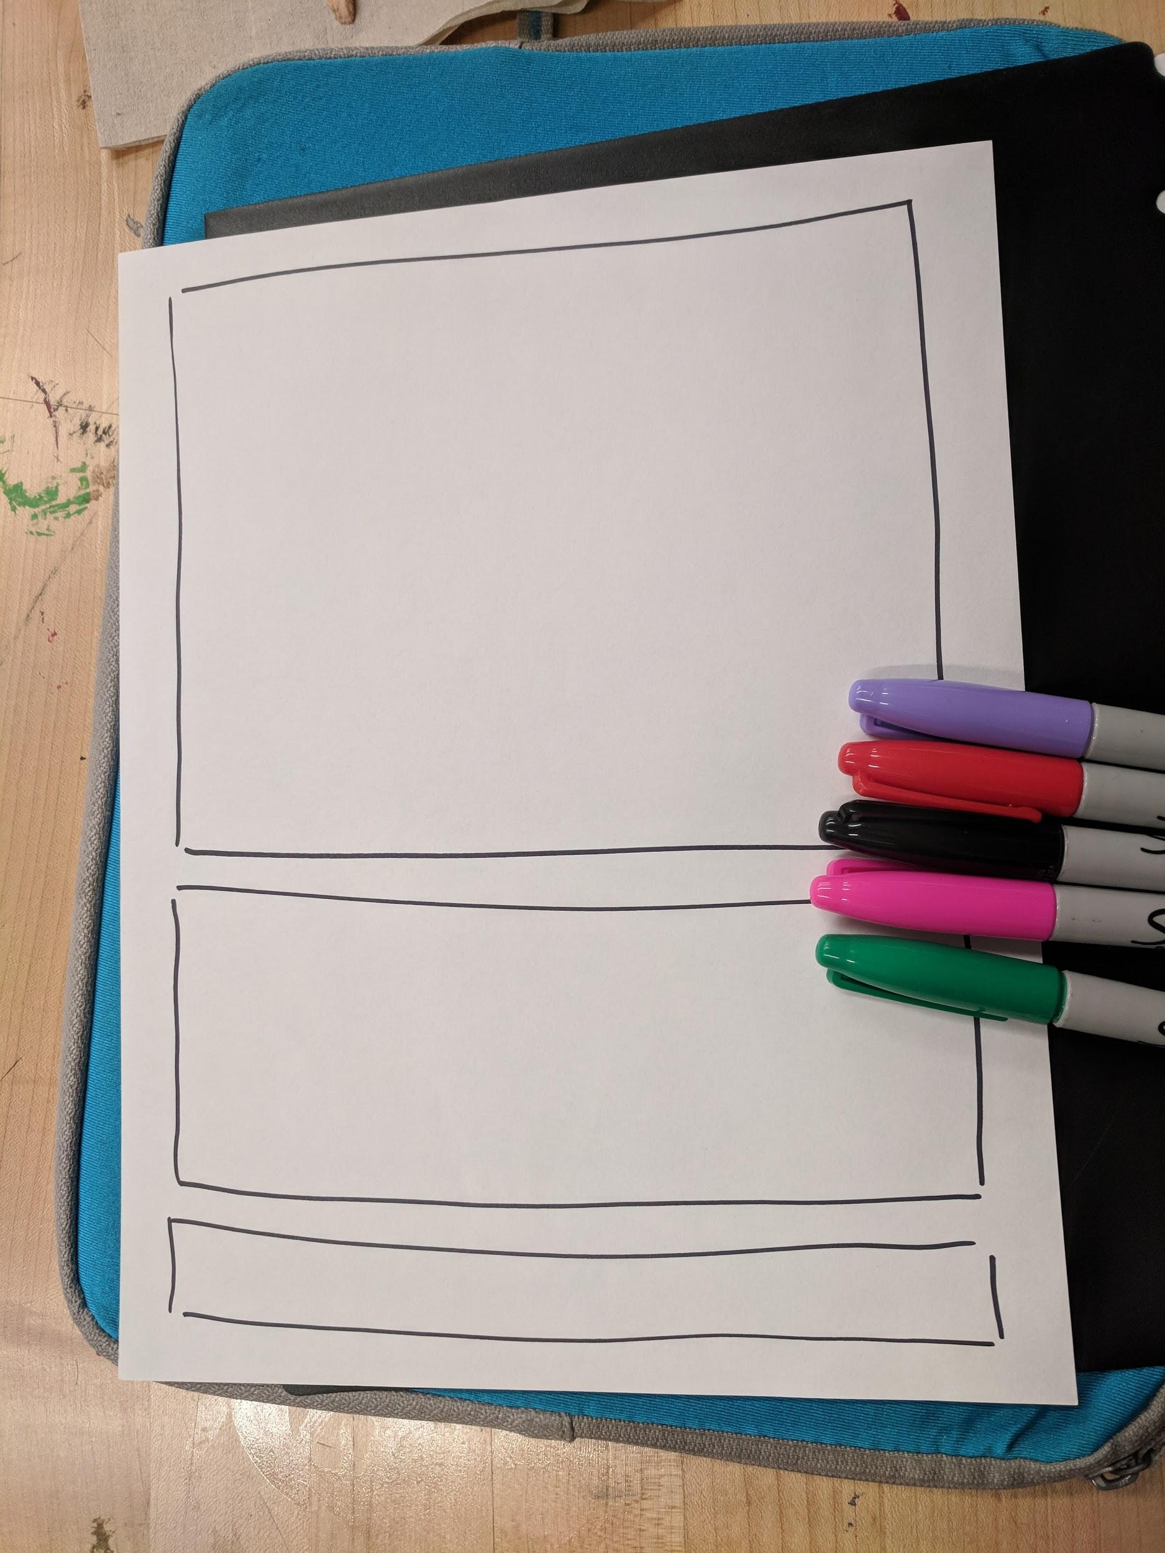
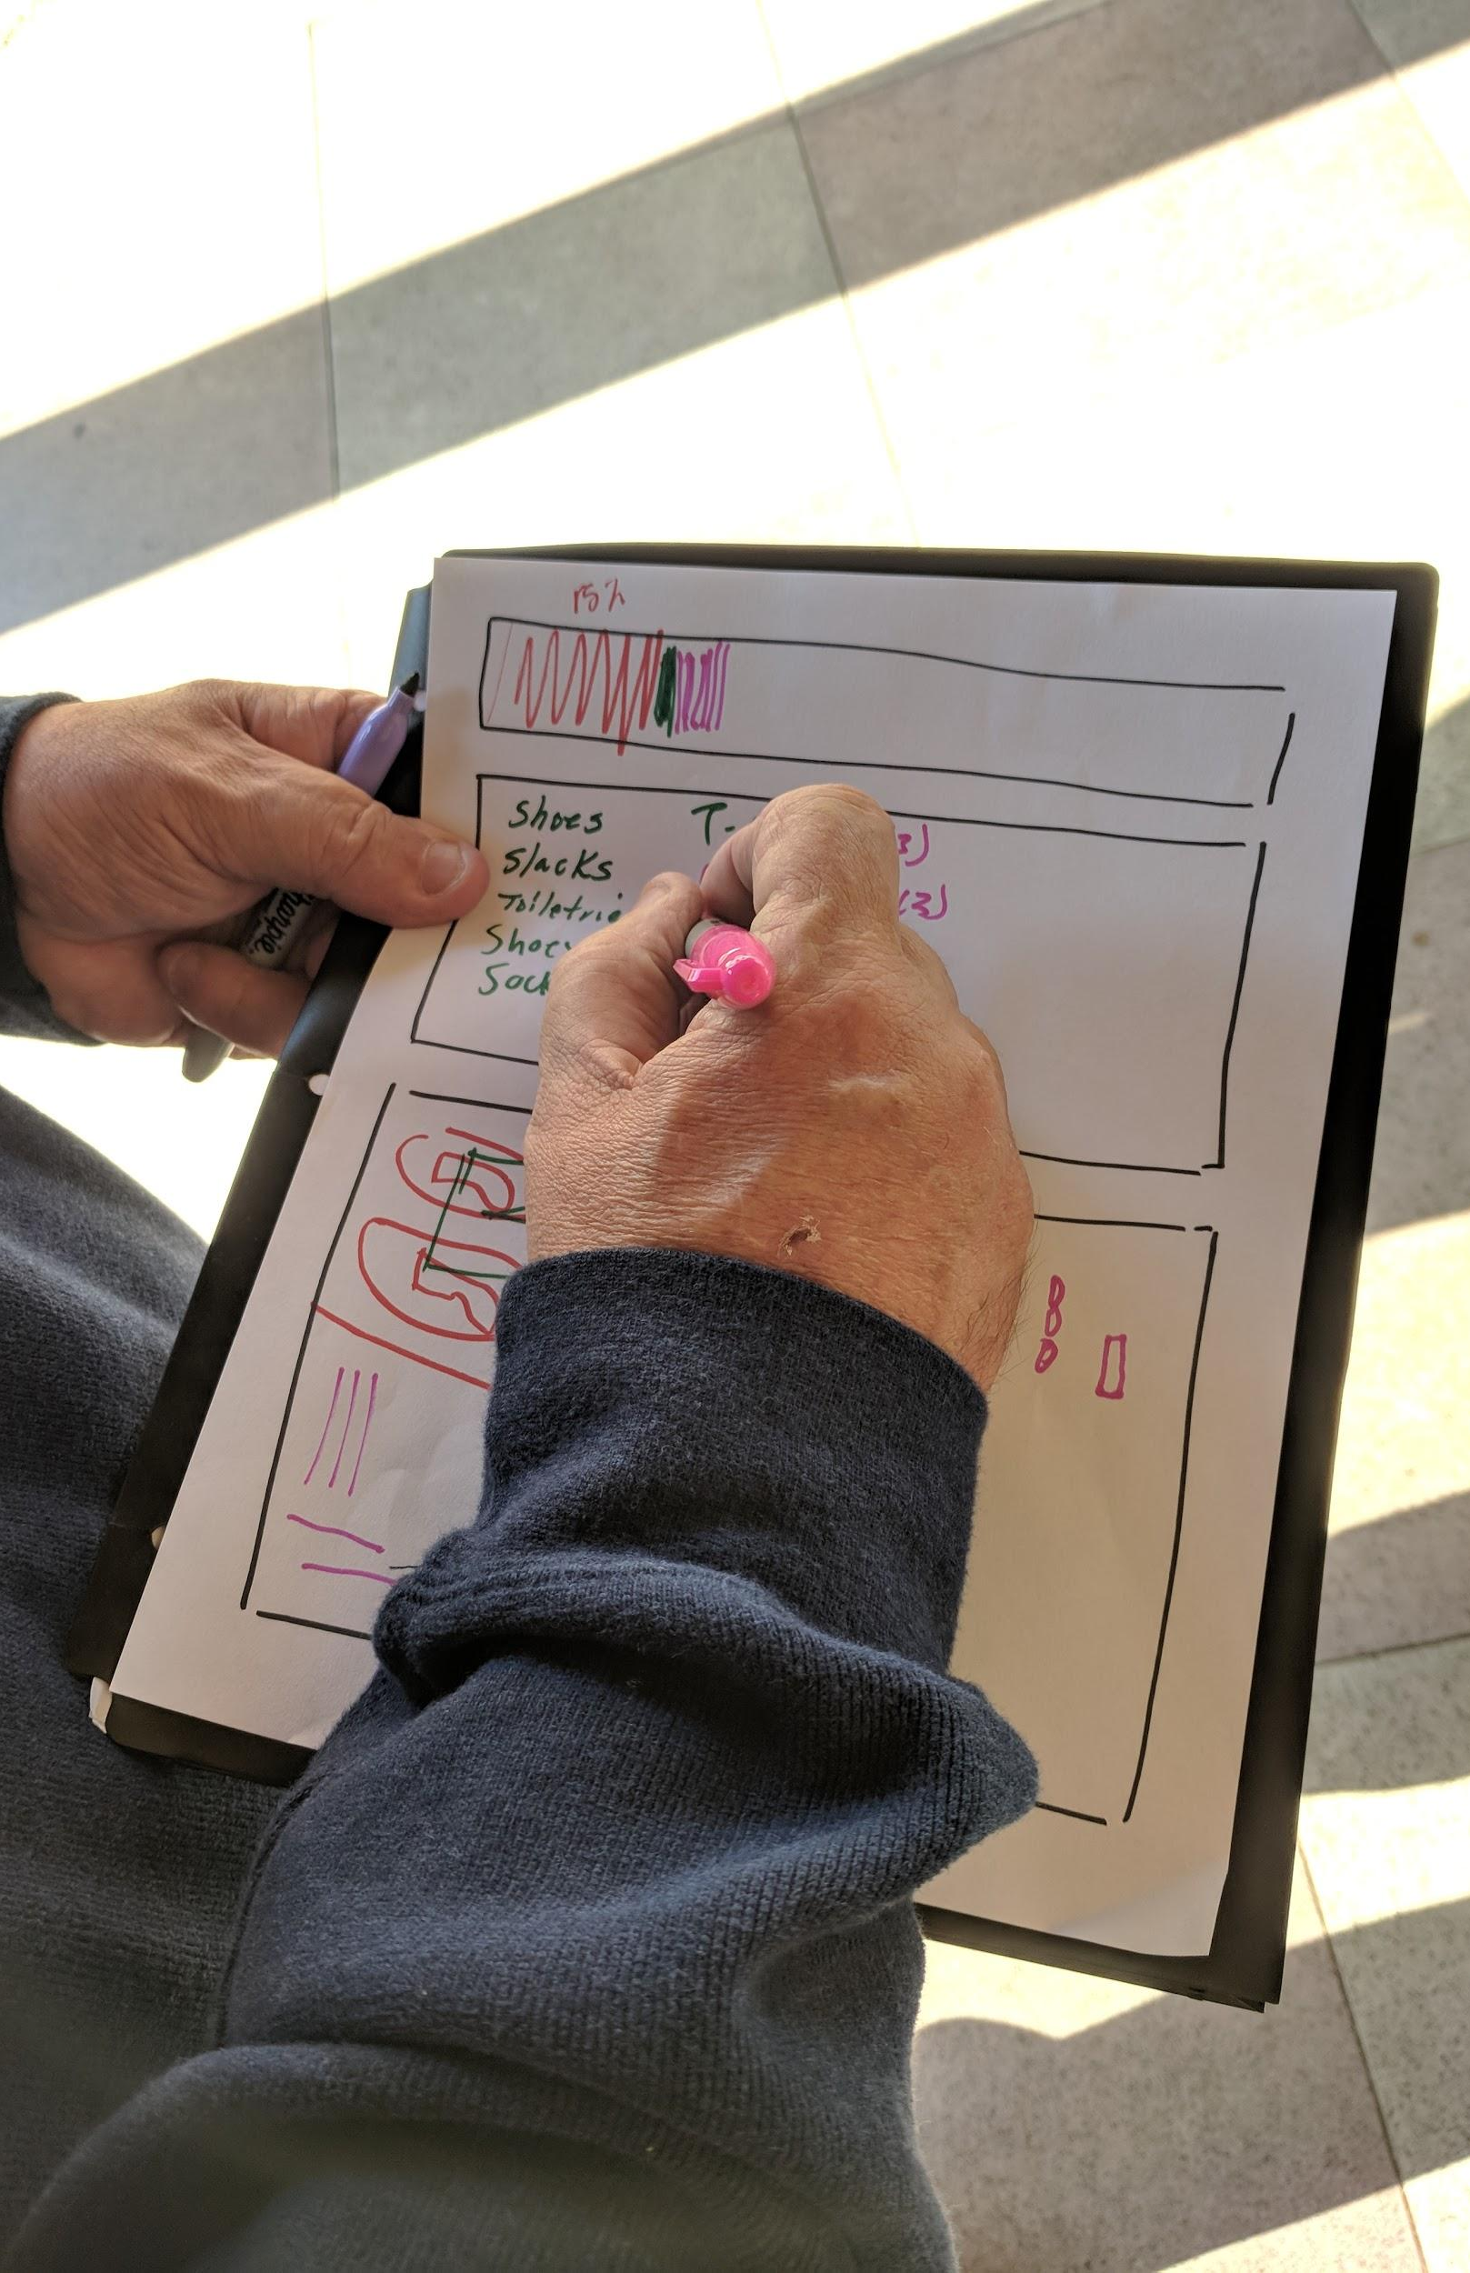
experience prototype
convenient
relevant & familiar information
not as practical for short trips
lack of 3D visualization
lack of split compartments

Slide 26
experience prototype
assumption
people value visualizing their items and plan beforehand when deciding what to pack
new assumption
packing visualizations would be more useful for long-term travelers

Slide 27
Bianca

Slide 28
needfinding, round two
Chelsea
Bianca
Cary

Slide 29
Cary

Slide 30
point of view
we met Cary, a Stanford CS (AI) senior and a semi-professional Youtuber
we were amazed to realize that he keeps random objects that he doesn’t necessarily feel an emotional connection with at the moment, for fear of developing feelings in the future
it would be game-changing to help him reconcile his emotions in a way that doesn’t take up as much physical space

Slide 31
how might we
how might we convert sentimental objects into new experiences that don’t take up physical space?

Slide 32
end of year bonfire
social decluttering

Slide 33
experience prototype
assumption
opinions of others are effective in finding inspiration and/or functionality in sentimental but otherwise useless objects

Slide 34
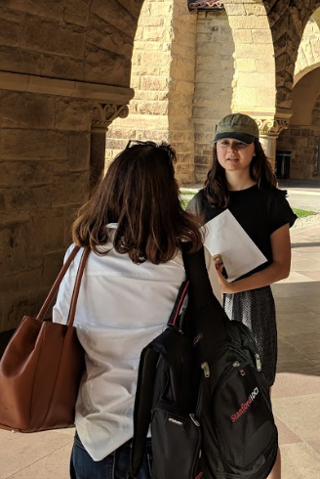
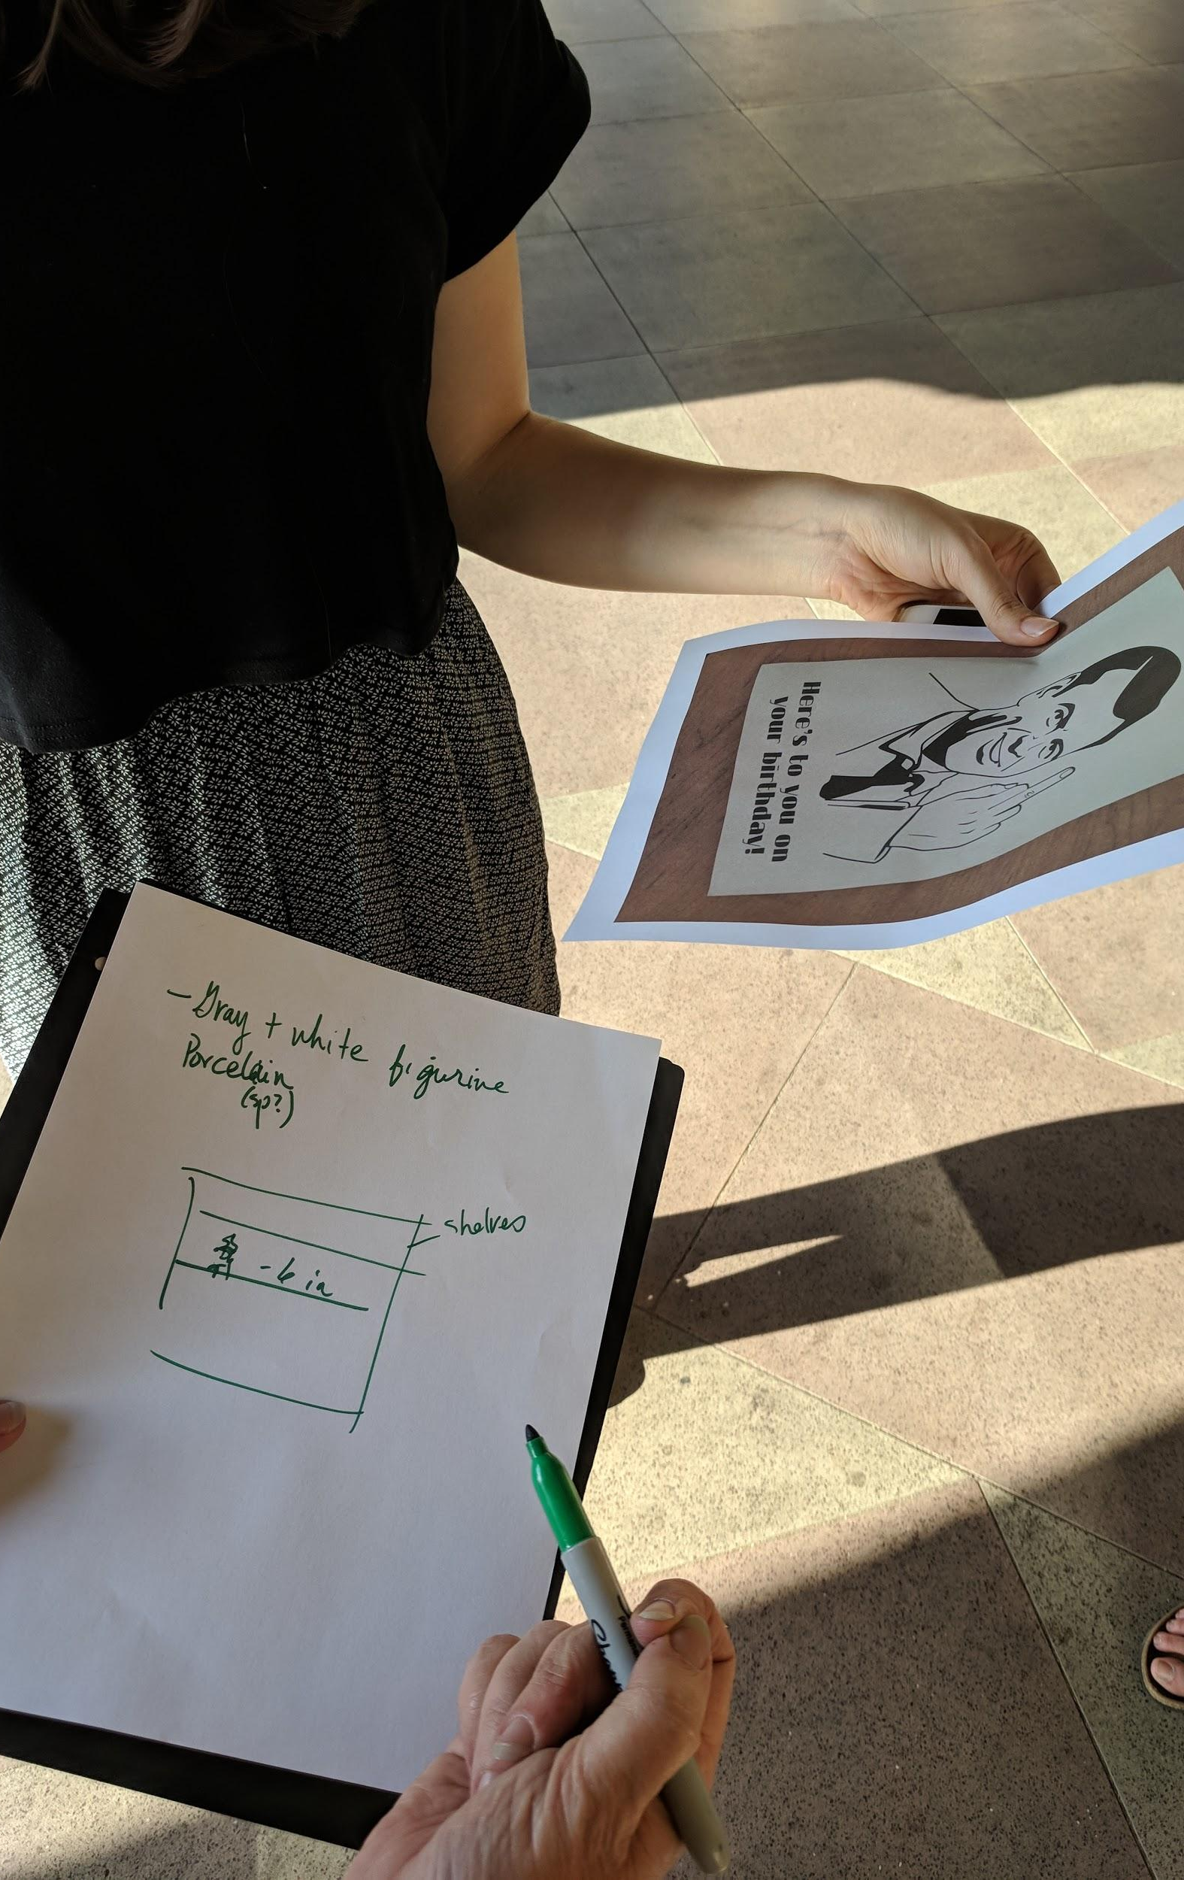
experience prototype
creatively stimulating
fun & exciting
facilitate communication
suggesting party emotionally removed
suggested actions often risky & pointless

Slide 35
experience prototype
assumption
opinions of others are effective in finding inspiration and/or functionality in sentimental but otherwise useless objects
new assumptions
act of generating ideas for others is exciting
but there may be more friction in executing more risk-averse, creative ideas

Slide 36
key takeaways

Slide 37
key takeaways
emotional confidence
shared experience
passing objects
social decluttering

Slide 38
key takeaways
decluttering of items with lesser sentimental value benefits from shared and creative experiences
taking care of more sentimental objects benefits from personal connection to, or reassurance from, the receiver

Slide 39
questions?

